Slide 1
Project Presentation of Gaming News Portal
By : Pratik Baishnav
Course : B.Sc.IT 3th
University Roll : 551217295

Slide 2
Statement of The Problem
The Scope of the website is wide and can be used by institutes or individuals and also can be used in offices with the necessary modifications done.
With this website, the manual functions is converted into automated web functions.

Slide 3
Objective and Scope of The Project
The purpose of this website is to support teaching, learning and research in the Education Sectors and in the Offices and by individuals as per the need, by developing and promoting access to information resources.
Helps to create a friendly environment between different users and staff personnel.
The three major components in the application are: -LOGIN -ADD NEWS -VIEW NEWS

Slide 4
Why is The Particular Topic Chosen?
Better and efficient service can be provided
Faster retrieval of information
Reduced workload of the newspaper and books
All details of the news will be available on a click
Less paper work and document maintenance

Slide 5
Methodology
The system supports the selection and implementation of Gaming News Portal.
A brief review of the nature and components of this system is offered as a basis.
The proposed methodology is drawn from established newspaper and book systems methodologies and from the literature on paper-based information systems.
Tools take the form of a series of checklists covering issues to be considered at various stages in the project.

Slide 6
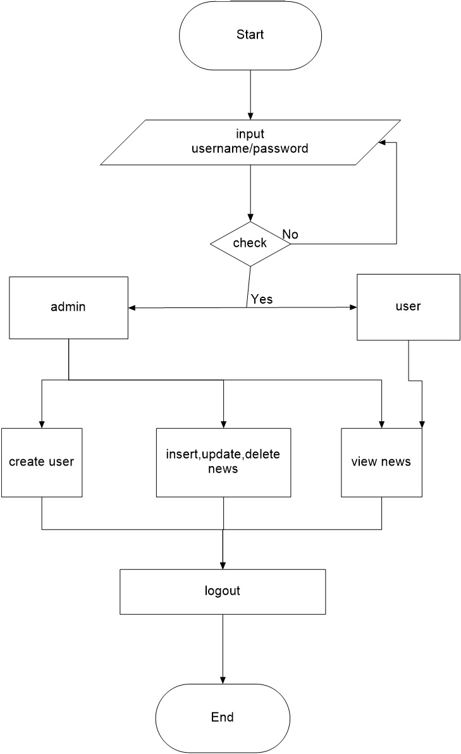
Flow Chart

Slide 7
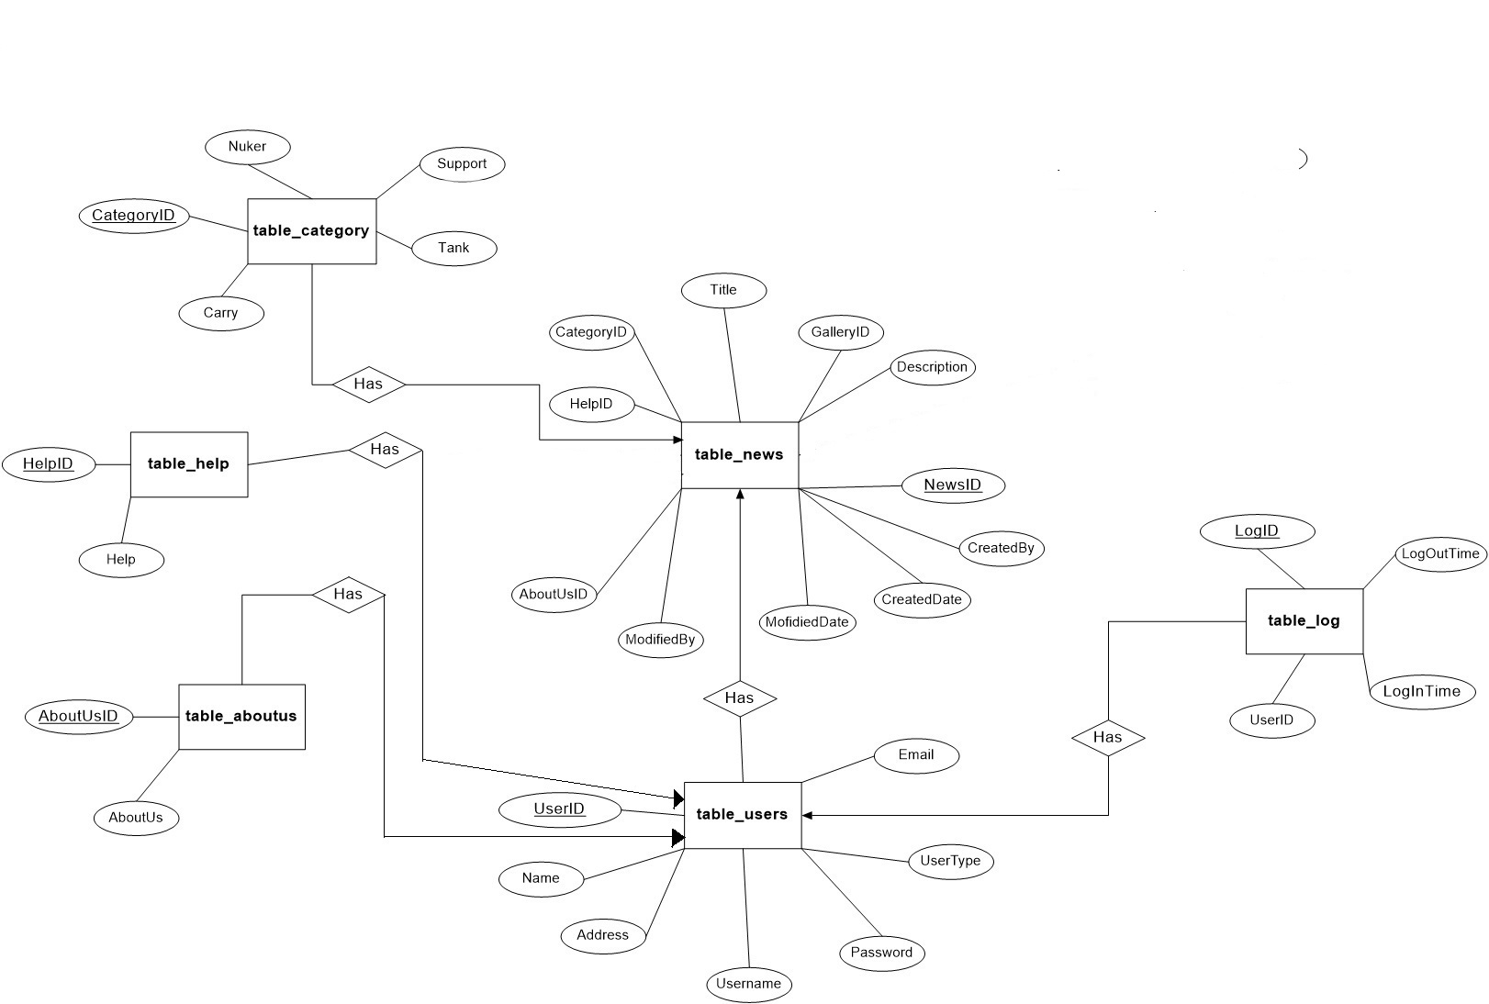
E-R Diagram

Slide 8
Requirements
Hardware
A Pentium 4 computer or higher.
2GB RAM for smooth environment.
Intel Processor or any other.
Software
Adobe Dreamweaver CS6
XAMPP 1.8.0

Slide 9
Components of the System
Front End
PHP
Back End
MySQL

Slide 10
Brief Overview
In overall this website allows admin and users to publish latest news or information and view news over the internet.
It deals with various functions like insert, update, view and delete of information or news.
In short this website is a friendly interface designed to carry out its task in a simple manner.

Slide 11
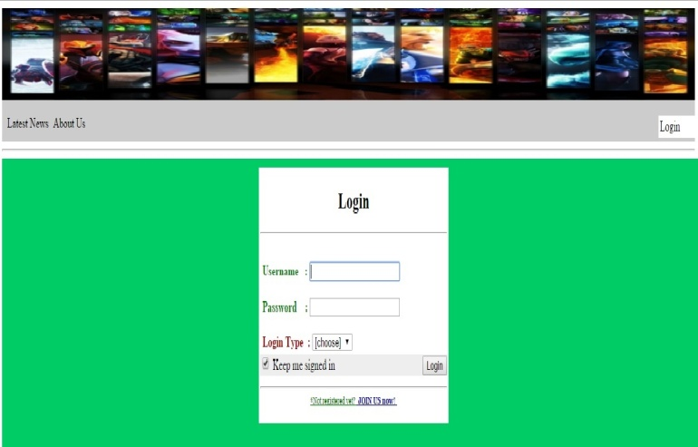
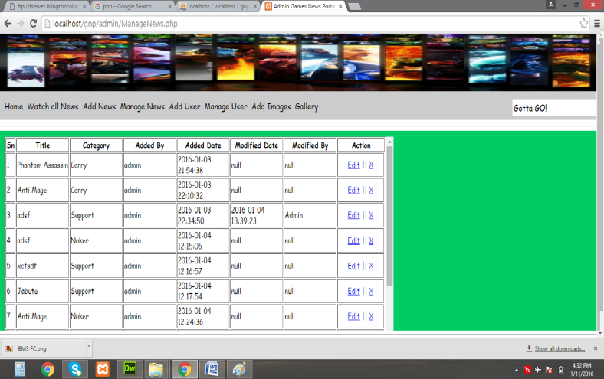
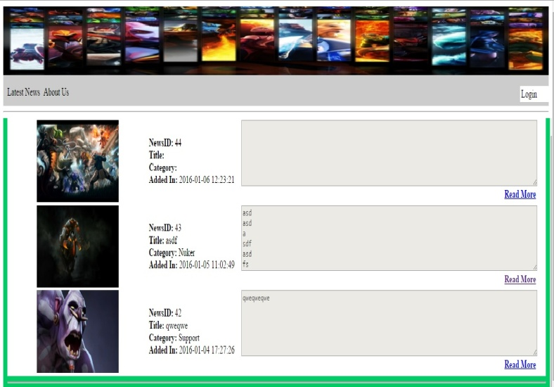
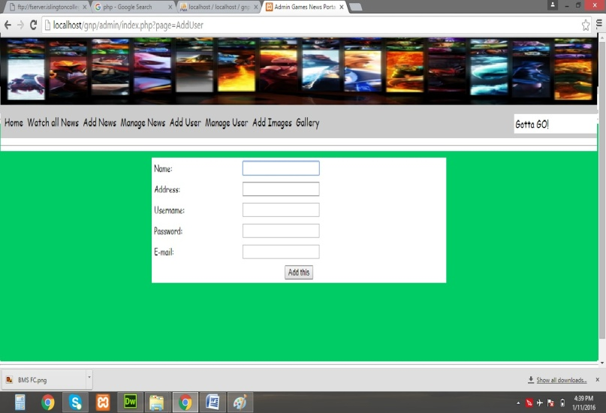
Some Pictures of the website

Slide 12
Thank You !!!!

